Slide 1
CENG 207 SOLID STATE DEVICES INSTRUCTOR: NANA(DR.) KWASI DIAWUO
LECTURE 6: METAL- SEMICONDUCTOR JUNCTION

Slide 2
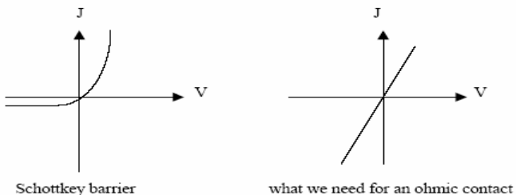
INTRODUCTION
Many of the useful properties of a p-n junction can be achieved by simply forming an appropriate metal-semiconductor contact.
Metal-semiconductor junctions are particularly useful when high-speed rectification is required.
On the other hand, we also must be able to form non-rectifying (ohmic) contacts to semiconductors.
Therefore, there are 2 types of Metal-Semiconductor contacts:
Schottky diode (rectifying contacts): Current easily flow in the forward direction and little current in the reverse direction
Ohmic contact (ohmic contacts): Current flows easily in both directions

Slide 3
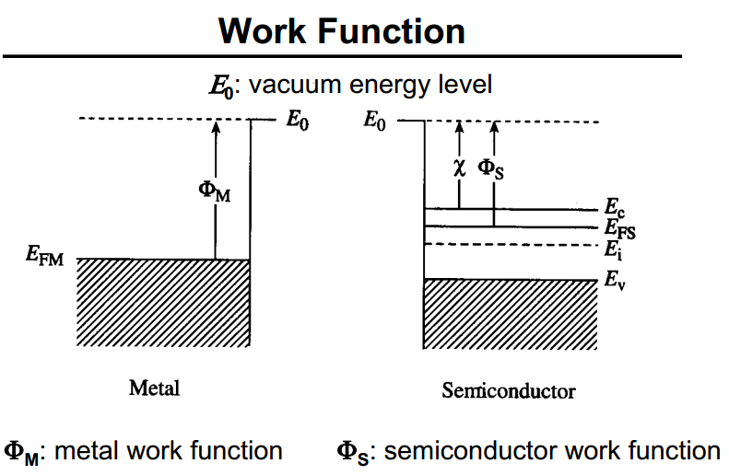
Work function(Φ): Is the energy required to move an electron from the Fermi level to the vacuum outside the metal/semiconductor
Electron affinity(χ): amount of energy needed to remove electron from Ec to vacuum energy level

Slide 4
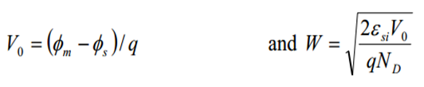
SCHOTTKY DIODE
When a metal with work function qΦm is brought in contact with a semiconductor having a work function qΦs, charge transfer occurs until the Fermi levels align at equilibrium
For example, when Φm > Φs the semiconductor Fermi level is initially higher than that of the metal before contact is made. To align the two Fermi levels, the electrostatic potential of the semiconductor must be raised (i.e., the electron energies must be lowered) relative to that of the metal.
In the n-type semiconductor, a depletion region W is formed near the junction. The positive charge due to uncompensated donor ions within W matches the negative charge on the metal. The electric field and the bending of the bands within W are similar to effects already discussed for p-n junctions.
For example, the potential barrier and depletion width W in the semiconductor can be calculated as

Slide 5
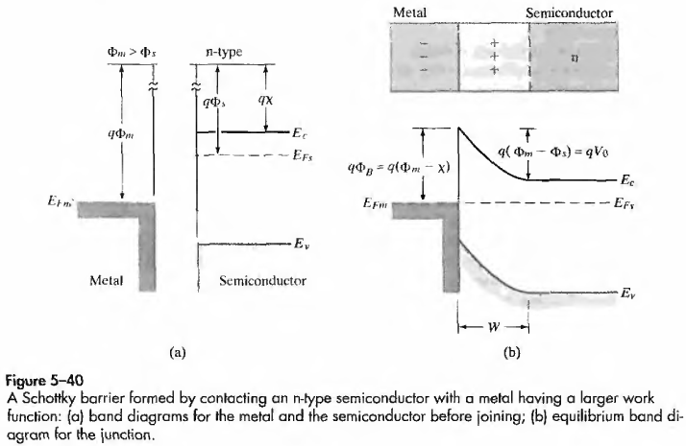

Slide 6
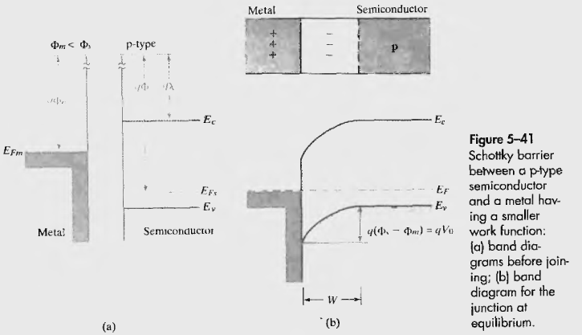

Slide 7
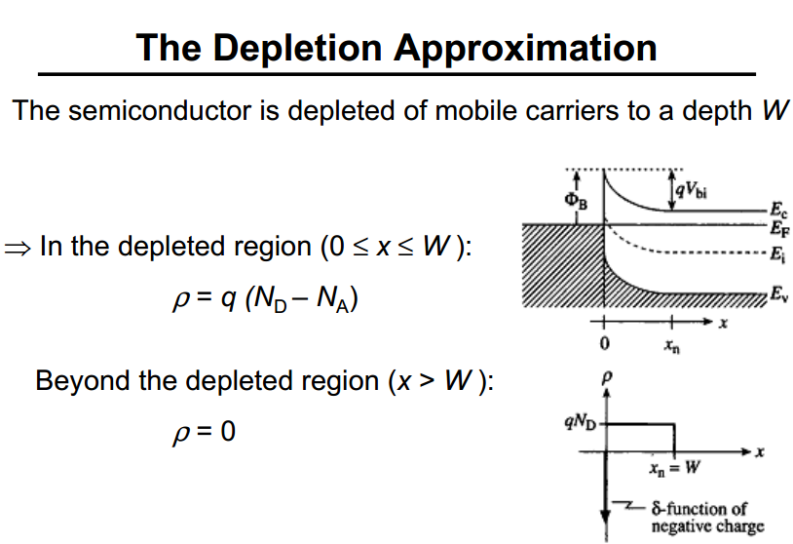

Slide 8
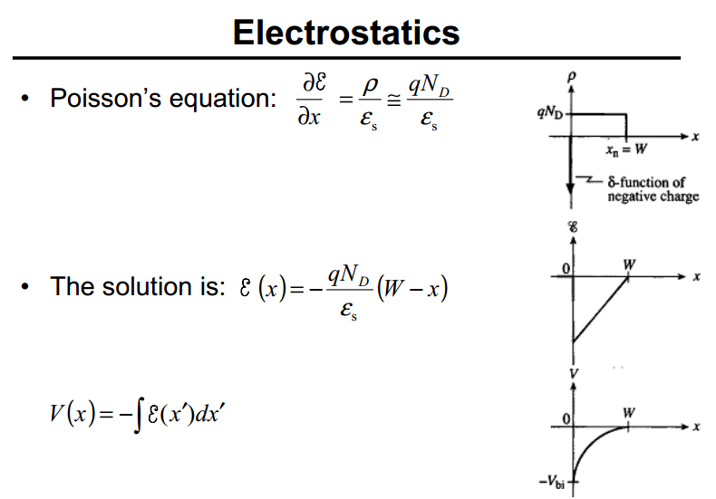

Slide 9
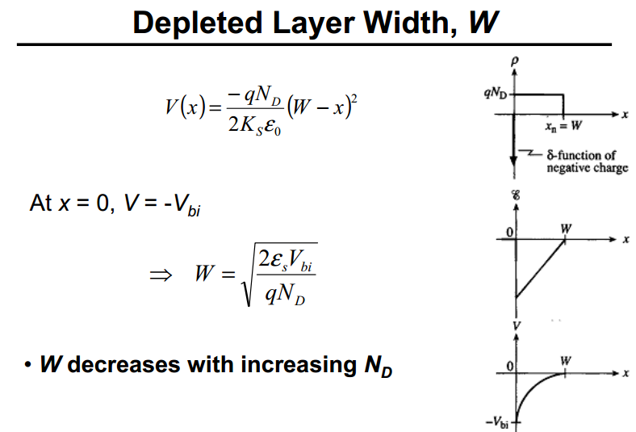

Slide 10
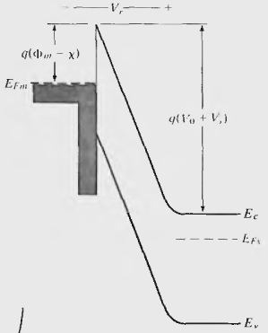
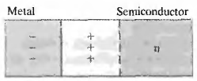
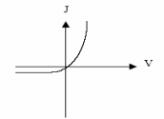
SCHOTTKY DIODE (reverse bias)
To reverse bias a schottky diode, connect the negative terminal of a battery to the metal(-ve)
The metal is charged even more negatively than without bias
Depletion width widens
Contact potential increases: reverse voltage increases the barrier, from Vo to Vo + V, for hole flow and the current becomes negligible.

Slide 11
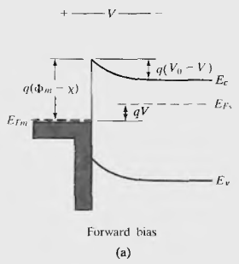
SCHOTTKY DIODE (forward bias)
To forward bias a schottky diode, connect the positive terminal of a battery V to the metal(-ve)
Depletion width narrows
Contact potential decreases: forward current increases as the battery lowers the potential barrier from Vo to Vo-V

Slide 12
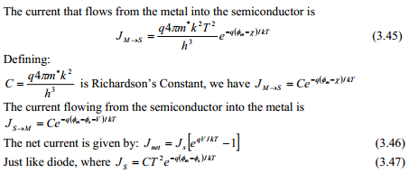
SCHOTTKY DIODE
In both forward and reverse biasing, electron-flow from the metal to semiconductor is retarded by the barrier Φm-χ. The resulting equation is similar in form to that of the p-n junction which is called the diode equation

Slide 13

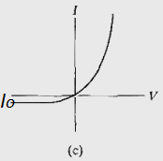
As Fig . c suggests
Io = Js
Reverse saturation current Io: One important feature we can predict intuitively, however, is that the saturation current Io should depend upon the size of the barrier ΦB =Φm-χ for electron injection from the metal into the semiconductor. This barrier is unaffected by the bias voltage.

Slide 14
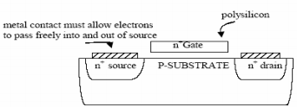
OHMIC CONTACTS
In many cases, we wish to have an Ohmic metal-semiconductor contact, having a linear I-V characteristic in both biasing directions.
For example, the surface of a typical integrated circuit is a maze of p and n regions, which must be contacted and interconnected. It is important that such contacts be ohmic with minimal resistance and no tendency to rectify signals.
Ideal metal-semiconductor contacts are ohmic when the charge induced in the semiconductor in aligning the Fermi levels is provided by majority carriers

Slide 15
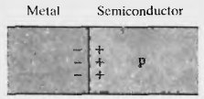
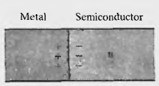
OHMIC CONTACTS
Unlike the rectifying contacts discussed previously, no depletion region occurs in the semiconductor in these cases since the electrostatic potential difference required to align the Fermi levels at equilibrium calls for accumulation of majority carriers in the semiconductor.
To achieve a contact which conducts easily in both directions, we dope the semiconductor very heavily
W is so narrow that carriers can tunnel directly through the barrier

Slide 16
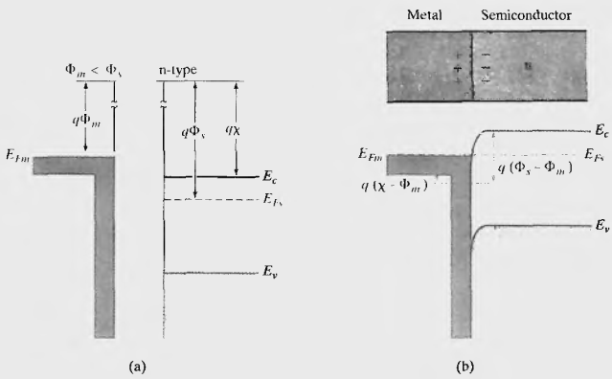
OHMIC CONTACTS
In Metal-N-type case, the Φm < Φs (n-type), the Fermi levels are aligned at equilibrium by transferring electrons from the metal to the semiconductor.
In this case the barrier to electron flow between the metal and the semiconductor is small and easily overcome by a small voltage.

Slide 17
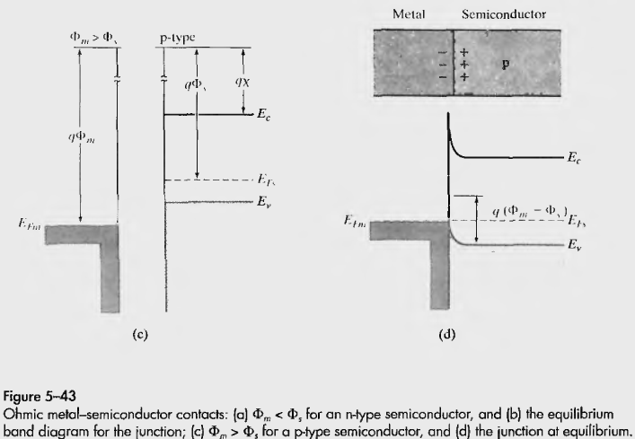
OHMIC CONTACTS
In Metal-P-type case, the Φm >Φs (p-type) results in easy hole flow across the junction

Slide 18
